Slide 1
DATAMITES
PROJECT TITLE : IMDB Movies Analysis
PROJECT ID: PRDA – 02
Presented By:
Paiaavula karthik
Email ID:
karthik.edu67@gmail.com

Slide 2
Project Description
Analyzed IMDB Movies data using SQL.
Extracted insights related to popularity, revenue, and ratings.
Performed director-wise analysis using joins and aggregations.
Improved practical understanding of SQL queries and data analysis.

Slide 3
Database Details
Database Name: project_movie_database
Tables Used:
movies
directors
Data stored in structured relational format

Slide 4
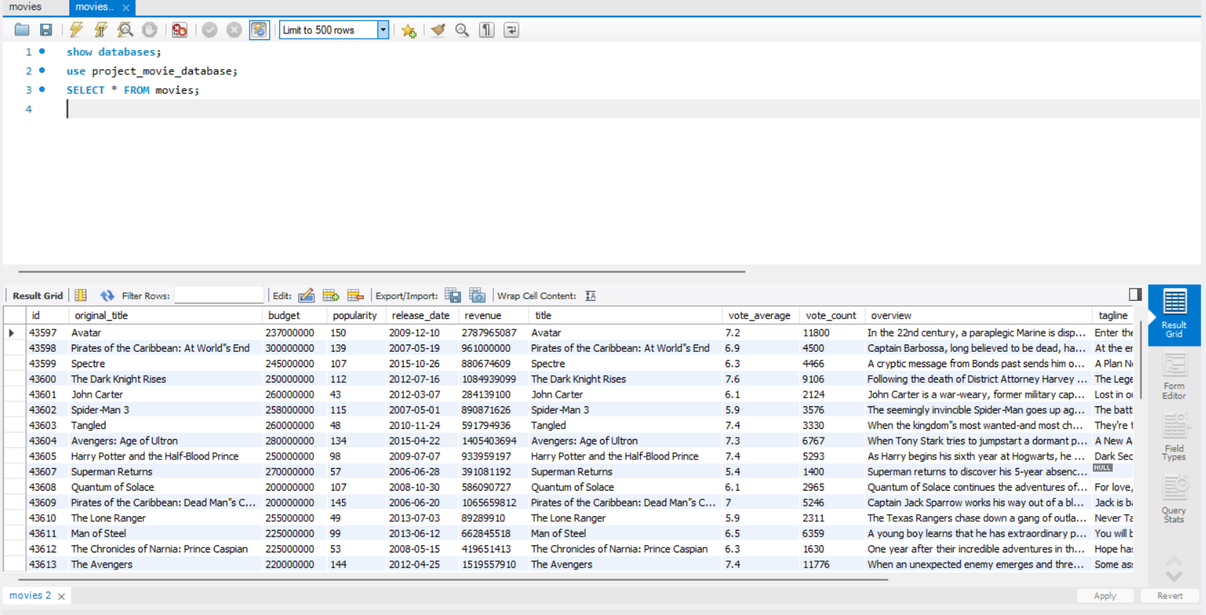
Get all data about movies
SQL Query:
SELECT * FROM movies;

Slide 5
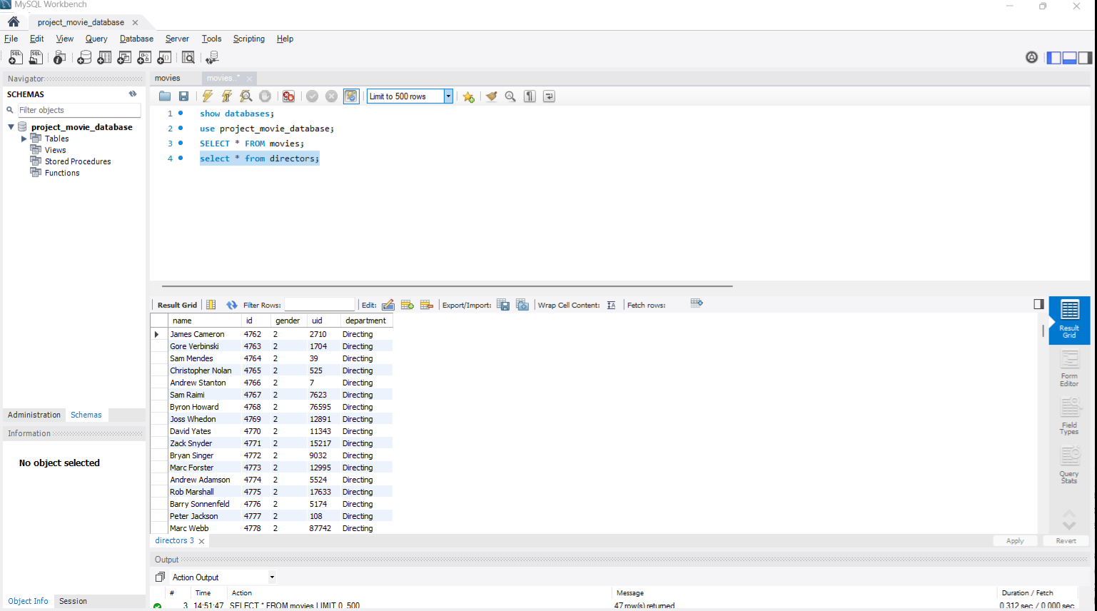
Get all data about directors
SQL Query:
select * from directors;

Slide 6
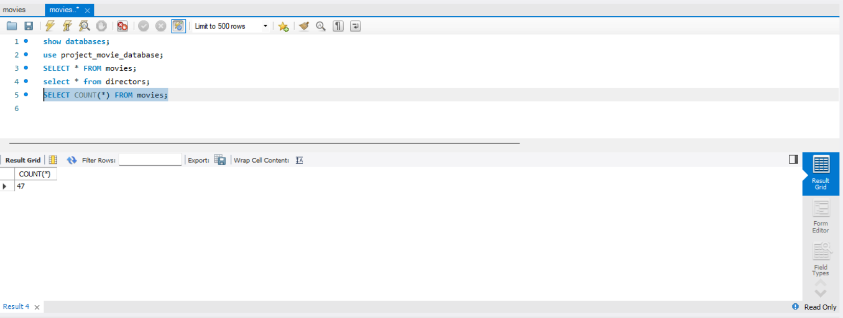
Check how many movies are in IMDB
SQL Query:
SELECT COUNT(*) FROM movies

Slide 7
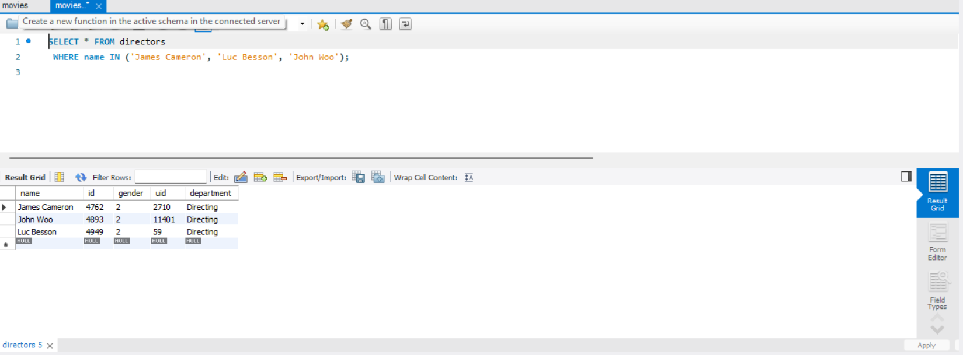
Find these directors: James Cameron, Luc Besson, John Woo
SQL Query:
SELECT * FROM directors WHERE name IN ('James Cameron', 'Luc Besson', 'John Woo');

Slide 8
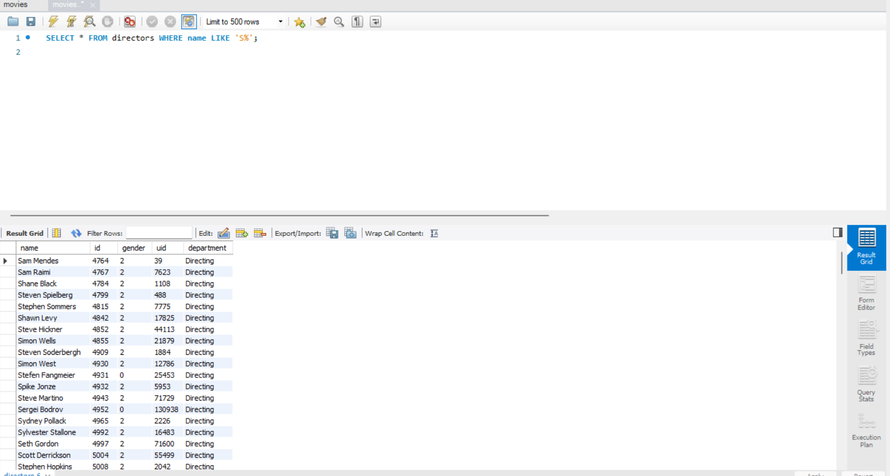
Find all directors with name starting with 'S'
SQL Query:
SELECT * FROM directors WHERE name LIKE 'S%';

Slide 9
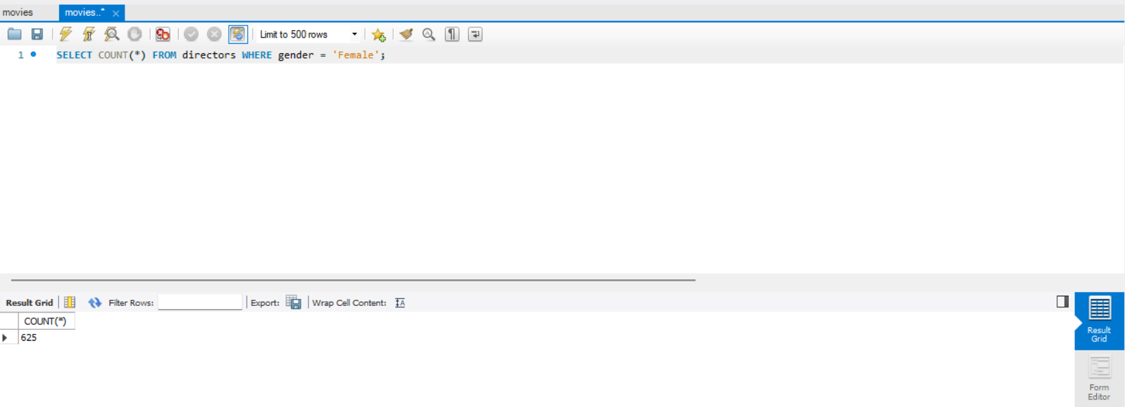
Count female directors
SQL Query:
SELECT COUNT(*) FROM directors WHERE gender = 'Female';

Slide 10
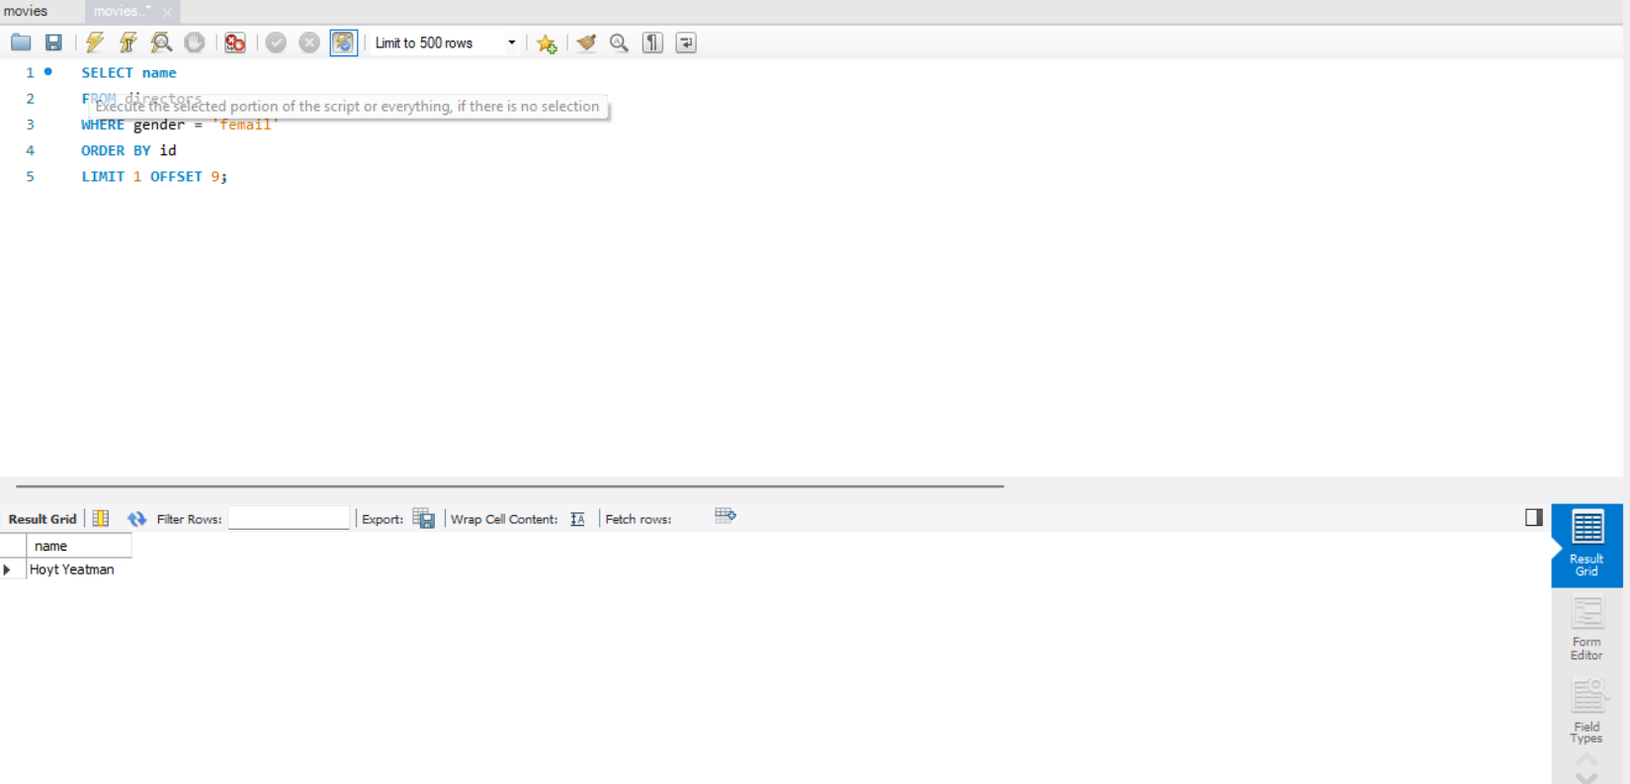
Find the 10th first woman director
SQL Query:
SELECT name FROM directors
WHERE gender = 'Female' ORDER BY birth_date LIMIT 1 OFFSET 9;

Slide 11
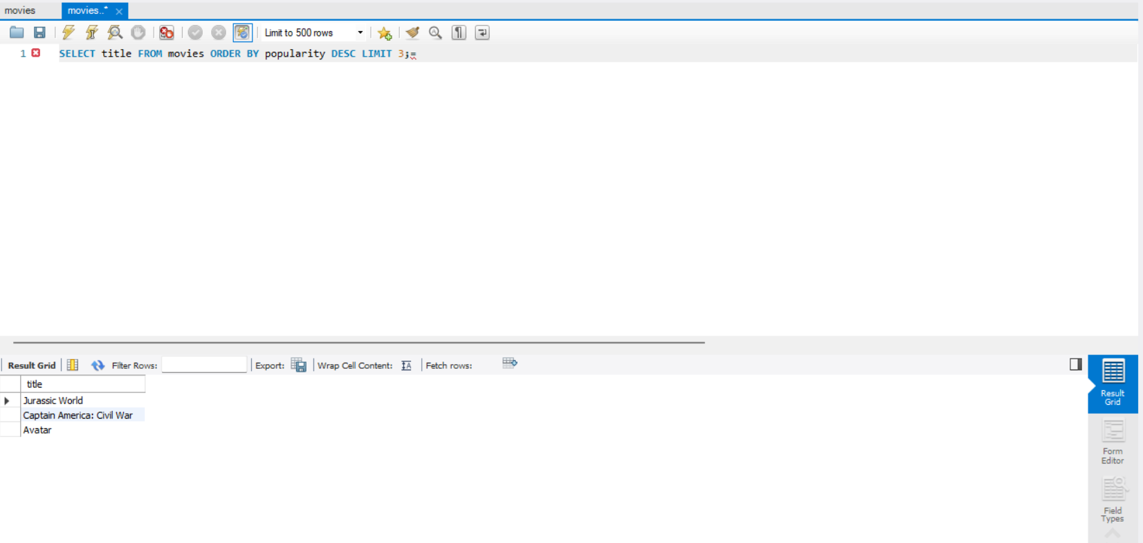
Top 3 most popular movies
SQL Query:
SELECT title FROM movies ORDER BY popularity DESC LIMIT 3;

Slide 12
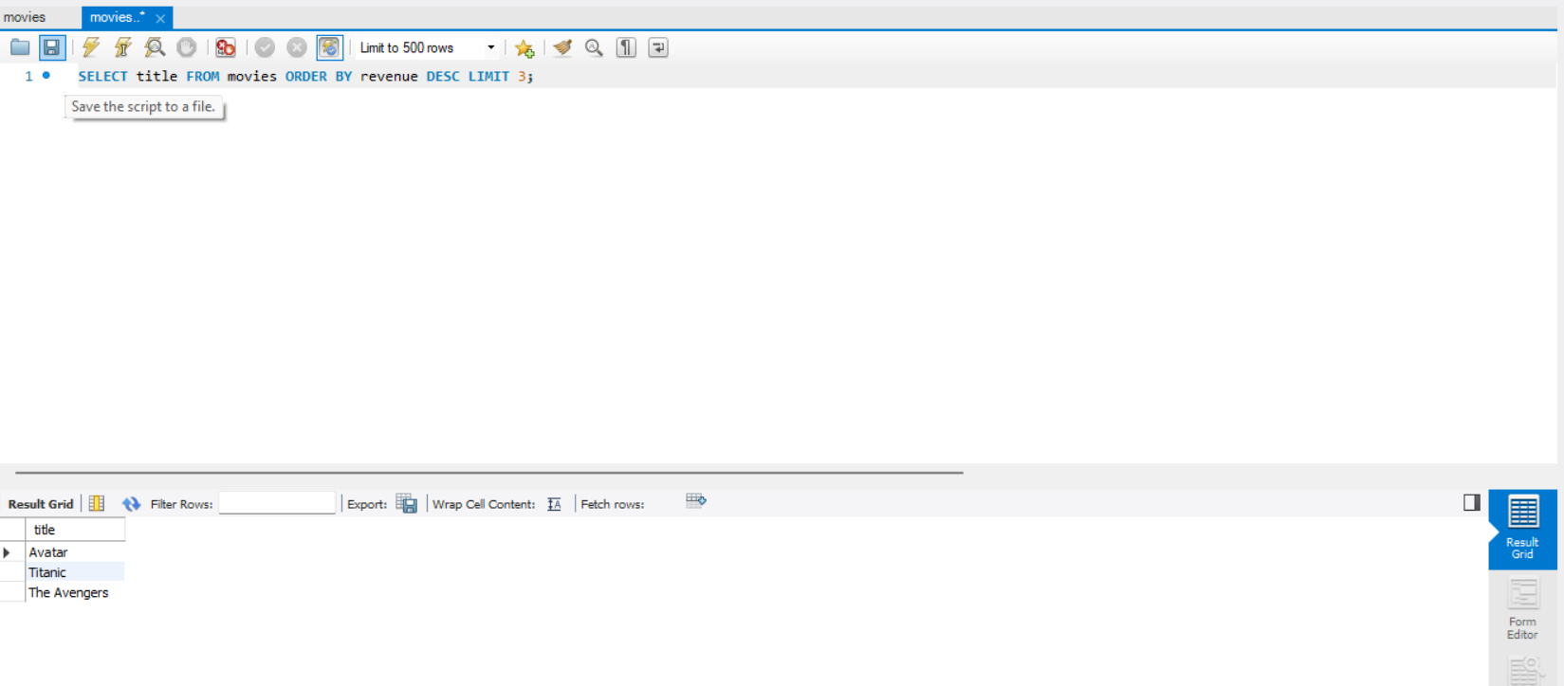
Top 3 most bankable movies
SQL Query:
SELECT title FROM movies ORDER BY revenue DESC LIMIT 3;

Slide 13

Most awarded movie since Jan 1, 2000
SQL Query:
SELECT title FROM movies
WHERE release_date >= '2000-01-01' ORDER BY 'awards' DESC LIMIT 1;

Slide 14
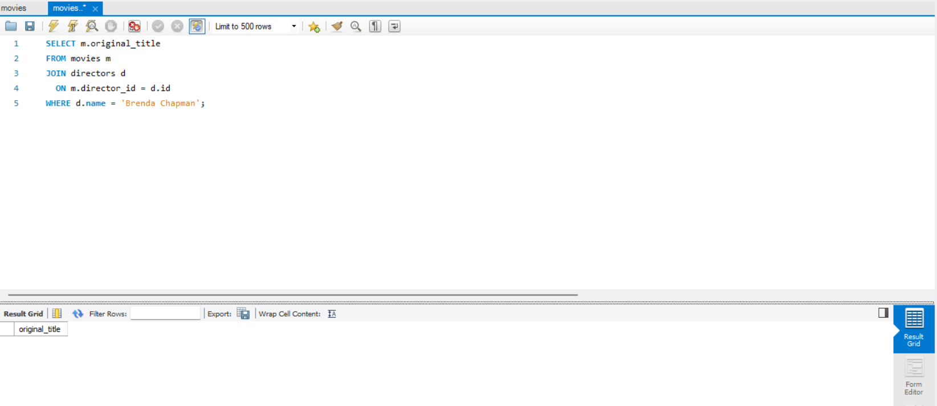
Movies directed by Brenda Chapman
SQL Query:
SELECT m.original_title FROM movies m JOIN directors d ON m.director_id = d.id WHERE d.name = 'Brenda Chapman';

Slide 15

Director who made the most movies
SQL Query:
SELECT 'director',COUNT(*)as movie_count FROM movies GROUP BY 'director'
ORDER BY movie_count DESC LIMIT 1;

Slide 16
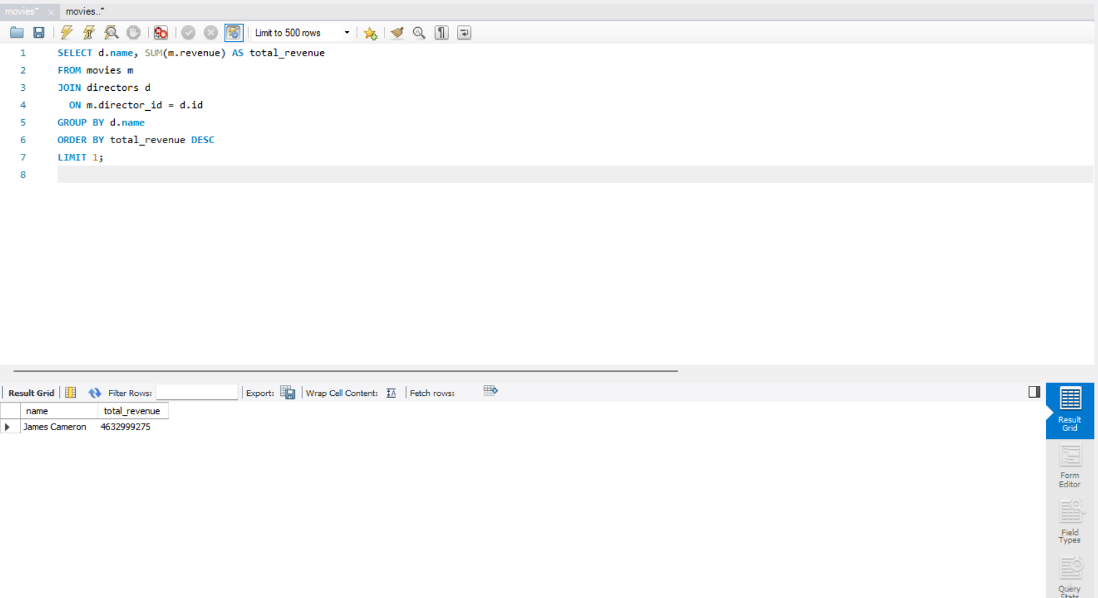
Most bankable director
SQL Query:
SELECT d.name, SUM(m.revenue) AS total_revenue
FROM movies m
JOIN directors d
ON m.director_id = d.id
GROUP BY d.name
ORDER BY total_revenue DESC
LIMIT 1;

Slide 17
Thank you

